Slide 1
Introduction to Next-Generation Sequencing
CITI Genomics workshop

Slide 2
Outline
What is next-generation sequencing, and how is it used?
How do you construct a sequencing library?
Sequencing-by-Synthesis: what a sequencing machine is really doing
Raw data format: Fastq files
Pipeline overview
File formats
Important parameters to consider
Read Mapping: SAM files
SNP Calling: VCF files

Slide 3
What is “Next-Gen” Sequencing (NGS)?
The term “next-gen” can be applied to numerous modern sequencing methods; the key criteria common to all NGS methods are:
High Throughput/ ”Massively” parallel
DNA synthesis and detection happen at the same time (sequencing-by-synthesis)
Low cost per base pair
NGS methods are distinct from what is called Sanger sequencing (the traditional, low-throughput method)
Commonly used NGS technologies:
Illumina
454 (Roche)
Ion Torrent
SOLiD
Nanopore
PacBio SMRT sequencing

Slide 4
NGS Methods and Their Applications
Platform | Chemistry | Read Length | Run Time | Total Gb/Run | Pros | Cons | Typical Uses
 | Reversible Terminator | ~100bp | 5 days | 200 Gb | Low cost per run High throughput Most commonly used | Short reads Long run times | Everything (DNA, RNA, CHiP, Micro-biome, etc.)
 | Pyro-sequencing | ~700bp | 1 day | 0.7 Gb | Long reads Commonly used | Lower total bases Higher cost | Microbiome, Amplicons, Exomes
 | Pyro-sequencing | ~100bp | 8 days | 60 Gb | Low error rate | Short reads Long run times | CHiP Seq Methylation sequencing
 | Proton detection | ~200bp | 2 hrs | 100 Gb | Short run time Affordable equipment | Shorter reads Fewer users | Clinical labs Microbiome Targeted seq
 | Electric Current Density | >10,000bp | 2 hrs | 10 Gb | Short run time No PCR step Long reads | Higher cost/read High error rates Biased errors | Repeated sequencing (monitoring) Field tests
 | Real-time single molecule sequencing | >10,000bp | 30 min. | 2 Gb | Short run time Longest reads No PCR step | Higher cost/read High error rate (but random errors) | Whole genome assemblies Resequencing

Slide 5
Whole Genome Sequencing (WGS)
Original, and still most common application of NGS
Most often used for Resequencing: sequencing an individual from a species that already has a publicly available reference genome
The purpose of resequencing is to find small scale variations among individuals
Mutations in the DNA: single base substitution, small deletions or small insertions
Typically referred to as SNPs (Single Nucleotide Polymorphisms)
SNP data is useful for many types of biological studies:
Medical: finding mutations that cause diseases, or markers that indicate a risk for disease
DNA fingerprinting: identifying individuals and testing relatedness (forensics)
Phylogenomics (finding evolutionary relationships among individuals or species)
Population genetics: testing for loci under natural selection, etc.
Agriculture: testing purity of seed stocks; using markers to select lines for breeding
And more!

Slide 6

Constructing an Illumina Library
Start with genomic DNA:
Flowcell Binding Site
Randomly fragment DNA:
(usually with sonication)
Add Forward and Reverse Adapters:
Forward Primer Site
Overhang
Overhang
Reverse Primer Site
PCR amplification:
Size Selection:
Final Library:
~500 bp

Slide 7
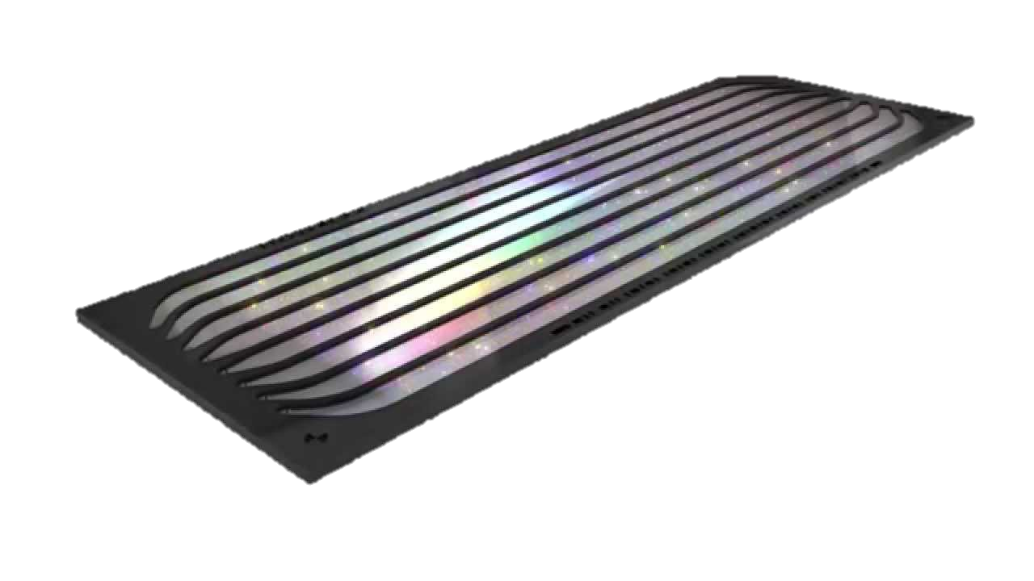
Sequencing-By-Synthesis
Library:
Illumina Flow Cell w/ 8 lanes
Flow cell is pre-coated with small DNA oligos
Fragments in the library are bound to the oligos on the flow cell (via the recognition seq. on the ends of the adapters)
A
Add labeled nucleotides
G
C
T
Base | Prob. Wrong
T | <1%
G
G
G
T
T
T
C
G
C
G
G
C
T
A
T
T
A
T
T
A
T
A
<1%
T
A
A
T
A
A
T
A
A
T
A
T
T
A
T
A
T
T
T
<1%
G
30%
In situ amplification creates clusters of identical copies of each fragment
Cross section of one cluster (notice there is a mutation/PCR error at one position)
Overhead view of the same cluster
Output

Slide 8
Illumina Output: Fastq Format
Base | Prob. | Phred Score | Code
T | 0.01% | 40 | H
A | 0.1% | 30 | ?
T | 0.05% | 33 | B
G | 30% | 5 | &
A | 1% | 20 | 4
C | 5% | 13 | .
Phred Score (Q) =
-log₁₀(Prob. of Error)
Code comes from a subset of ASCII characters
**Note that different versions of Illumina use slightly different sets of codes
Single Cluster
Sequencing-By-Synthesis
@Seqname:Flowcell:Lane:X1:Y1
TATGAC
+Seqname:Flowcell:Lane:X1:Y1
H?B&4.
@Seqname:Flowcell:Lane:X2:Y2
AAAGGG
+Seqname:Flowcell:Lane:X2:Y2
HH??AB
Fastq format (.fq or .fastq):
A text file with 4 lines per sequence

Slide 9
Data Processing Pipeline
Quality Check
Trimming
Remove leftover adapters
Map to Reference
Sort mapped reads
Merge aligned reads for all individuals
Find any site different b/t at least 2 samples
Raw Data
Cleaned Data
Aligned Reads
SNPs
FASTQ
FASTQ
SAM/BAM
VCF
Minimum quality to “trust” a base call
How many mismatches to allow
Coverage req. to call a SNP w/in a sample
Minimum length to keep a trimmed read
# Samples required to keep SNP
Min. mapping quality to trust a read

Slide 10
Read Mapping/Alignment
Reference Genome:
4
2
1
3
4
3
Read ID | Mapped Pos. | Mapping Qual. | CIGAR string
1
3553
37
100M
2
2041
37
5M1I9M3D85M
1
3
3998
10
100M
Some reads from a .fq file:
2
4
114
0
100M
3
5
*
*
*
4
Real SAM format has 11 fields or more (https://genome.sph.umich.edu/wiki/SAM)
Default SAM: 1 line per alignment, BUT
Default BWA/Bowtie: 1 line per read, with best alignment
5

Slide 11
SNP Calling
Coverage too sparse
Reference Genome:
Typical Default: 10X cov
Map. Rds
Sample 1:
Map. Rds
Sample 2:
Missing 1 sample completely
SNP Pos | Ref | Alt | Qual | Format | Sample 1 | Sample 2
1055 | T | G | 30 | GT:DP:AD:GQ | 1/1:3:0,3:37 | 0/0:3:3,0:23
2113 | G | T | 20 | GT:DP:AD:GQ | 0/0:3:3,0:37 | 1/1:3:0,3:16
4678 | T | C | 33 | GT:DP:AD:GQ | 0/0:3:3,0:22 | 0/1:4:1,3:35
8327 | A | C | 16 | GT:DP:AD:GQ | 0/1:4:1,3:12 | 0/0:3:3,0:18
Full VCF details:
https://en.wikipedia.org/wiki/Variant_Call_Format
Type of quality value will depend on SNP calling program used
Vcftools (http://vcftools.sourceforge.net/) is a useful suite of programs for filtering and manipulating vcf files after calling SNPs

